Slide 1

AZURE DATA FUNDAMENTALS Microsoft Certified: DP-900
Student Name: Om Singh
UID: 23BDA70214
Email ID: 23bda70214@cuchd.in
DISCOVER . LEARN . EMPOWER

Slide 2
TOPICS TO BE COVERED
Introduction
About Technology
Weekly Schedule
Certification Done
Conclusion and Future Scope
References

Slide 3
Introduction
• Azure Data Fundamentals (DP-900) is a beginner-level certification
• Demonstrates foundational knowledge of core data concepts
• Covers Microsoft Azure data services and cloud data solutions
• Ideal for candidates beginning to work with data in the cloud
• 45-minute exam with multiple-choice questions
• Validates understanding of relational and non-relational data
• Prepares for advanced Azure role-based certifications

Slide 4
About Technology
Core Data Concepts (25-30%):
• Structured, semi-structured, and unstructured data
• Data file formats (CSV, JSON, XML, Parquet, Avro)
• Transactional (OLTP) and analytical (OLAP) workloads
Relational Data on Azure (20-25%):
• Azure SQL Database, PostgreSQL, MySQL
• Tables, normalization, SQL queries
Non-Relational Data (15-20%):
• Azure Cosmos DB, Blob Storage, Table Storage
Analytics Workload (25-30%):
• Azure Synapse, Data Factory, Databricks, Power BI

Slide 5
Weekly Schedule
Week 1: Introduction to Core Data Concepts
• Data types and representations
• File formats and database types
Week 2: Relational Data on Azure
• Azure SQL services and database concepts
• SQL queries and table operations
Week 3: Non-Relational Data on Azure
• Azure Cosmos DB and NoSQL concepts
• Azure Storage services
Week 4: Analytics Workload on Azure
• Azure Synapse Analytics and ETL processes
• Power BI and data visualization

Slide 6
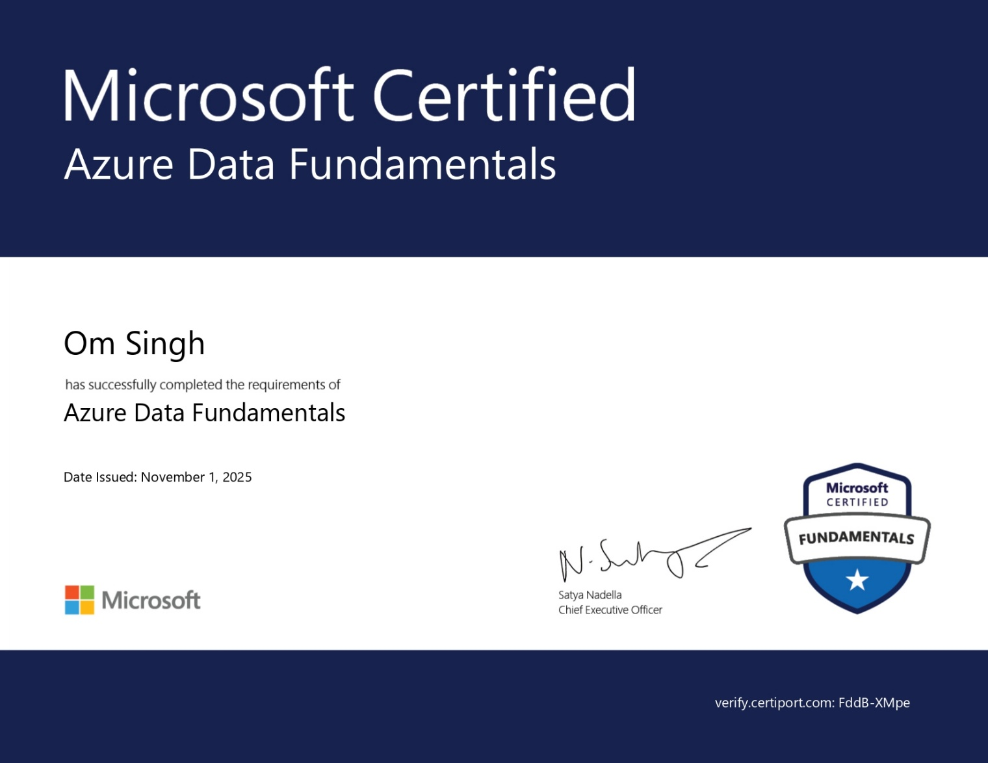
Certification Done
Microsoft Certified: Azure Data Fundamentals
• Certification Name: Azure Data Fundamentals
• Exam Code: DP-900
• Certification Level: Beginner/Fundamental
• Exam Duration: 45 minutes
• Exam Cost: $99 USD
• Delivery Method: Online proctored through Pearson VUE
• Passing Score: 700/1000
• Skills Validated: Core data concepts, relational data, non-relational data, analytics workload on Azure
• Preparation Time: 4 weeks of focused study
• Status: Completed Successfully

Slide 7
Conclusion
Key Learnings:
• Comprehensive understanding of Azure data services
• Knowledge of both relational and non-relational databases
• Skills in data analytics and visualization concepts
• Foundation for cloud data engineering career

Slide 8
Future Scope
Future Opportunities:
• Pursue Azure Database Administrator Associate (DP-300)
• Advance to Azure Data Engineer Associate (DP-203)
• Explore Azure AI and Machine Learning certifications
• Apply skills in real-world data projects
• Career paths: Data Analyst, Data Engineer, Database Administrator

Slide 9
References
Microsoft Learn - Azure Data Fundamentals https://learn.microsoft.com/en-us/credentials/certifications/azure-data-fundamentals/
Exam DP-900 Study Guide https://aka.ms/dp900-StudyGuide
Microsoft Azure Documentation https://docs.microsoft.com/en-us/azure/
Azure Data Services Overview https://azure.microsoft.com/en-us/products/category/databases/
Practice Assessment for DP-900 Microsoft Learn Platform

Slide 10
THANK YOU

